Slide 1
Birth of the Narcos
Pan-American Illicit Networks, 1945-1965

Slide 2
How do we think about….
Drug trafficking in the 21st century?
Who does it?
Where does it come from?

Slide 3
So how should we think about the term….
“Pan-American”?

Slide 4
Between 1947 and 1964….
“a wholly new class of international cocaine traffickers swiftly arose, formed by little-known Peruvians, Bolivians, Cubans, Chileans, Mexicans, Brazilians, and Argentines.”
First – what to make of this timing (think about discussions from last week)?
Began making connections to such US cities as New York and Miami.
This “pre-Colombian” routes helped set the stage for the explosion of cocaine in the 1970s…

Slide 5
The era of mass smuggling of cocaine from South America….
Seems to kick off in the late 1930s.
Making this possible?
Technology: the rise of passenger air travel – and then international air travel.
Demand: migration and immigration have brought customers to places like New York.
Culture: emerging jazz scene and white counterculture and its attitude toward drug use.

Slide 6
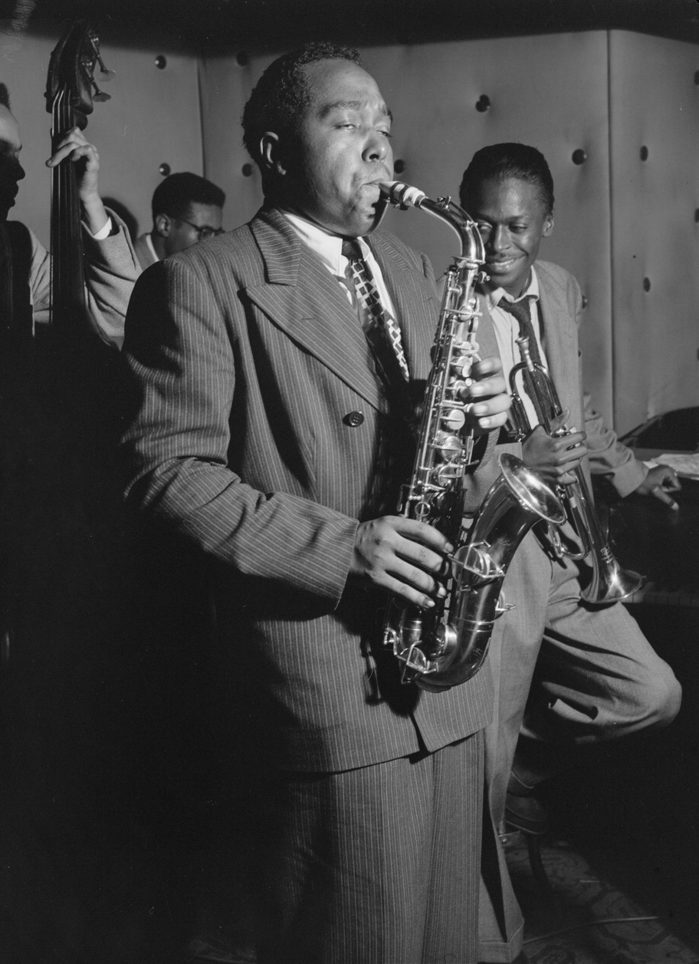
Jazz performers….

Slide 7
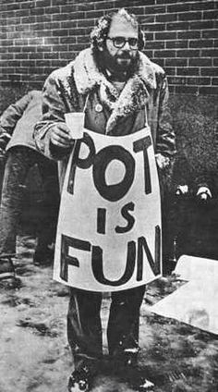
The Beat Generation….

Slide 8
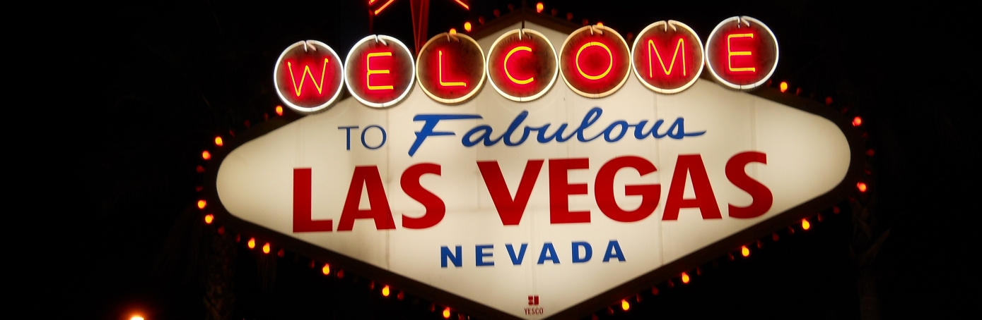
And, over time, urban development….

Slide 9
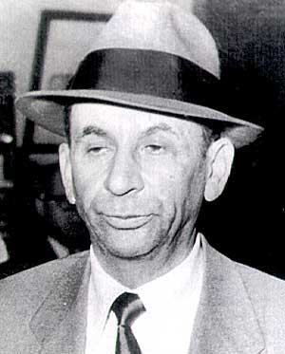
Meyer Lansky

Slide 10
When World War II….
Interrupted narcotics shipments to the US from Asia and Europe, gangster Lansky opened a new route through Mexico.
Point person in Mexico? Howard “Happy” Meltzer.
And in charge of getting the drugs into the US?

Slide 11
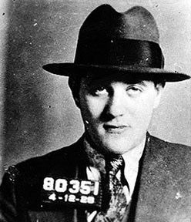
Bugsy Siegel

Slide 12
Siegel….
Oversaw a fleet of planes, speedboats, and cars smuggling opium into Southern California.
Often smuggled the drugs himself in his Chrysler Royal convertible.

Slide 13
Las Vegas….
Became a sort of way-station for this drug trade, as the product would then go out to the coasts and the Midwest.
Also a place to both launder and invest drug money.
It was drug profits that paid for Siegel’s Flamingo casino.
Opened in 1947 and marked the beginning of the modern Las Vegas Strip.

Slide 14
Elsewhere in the US….
Who is leading the charge?
“Chile, with Cuba, was the major and now-forgotten transit route for illicit cocaine through the 1950s.”
Why Cuba?
For Chile, geography helped here: it bordered Peru and served as Bolivia’s outlet to the sea.
The Huasaff-Harb clan emerged as the dominant force in Chile, building cocaine labs as early as 1952.
Paid off politicians and the police (starting a long-running tradition).
Why would such officials be likely to take bribes?
But still ended up getting caught in 1959 (after the downfall of their police protector).
What did this do to drug trade?

Slide 15
It dispersed it throughout the region
“Their prosecution, however, mainly served to disperse cocaine into a more competitive enterprise employing hundreds of Chileans. After 1960, ever more cocaine moved to Mexico.”
Will see next week why this is so important….
Yet Chile’s role in the drug trade takes a hit with the September 1973 military coup.
This event “pushed the cocaine traffic out of the divided country toward Colombia, where it would blossom in coming years.”
Again, will see why this was so important.
And one last thing: unintended consequences of Cold War era US foreign policy.

Slide 16
Closer to the United States….
“Cuba was the hub for the development of international cocaine traffic and tastes for the drug during the 1950s.”
It fit in well with Cuba’s gambling and pleasure clubs and prostitution industry (think Godfather II).
Became a sort of distribution center for cocaine coming from places like Bolivia.
Post 1959 revolution? “The Cuban Revolution marked a turning point in cocaine’s history in which it was dispersed to widely scattered markets by a new Pan-American class of career traffickers.”

Slide 17
This included…
Traffickers in places like Argentina and Brazil.
But also Mexico, Panama, Ecuador, and Colombia.
This is ground zero of the modern global drug trade – and no one was really paying that close attention.
Speaking on Colombia: “Thus, prior to cocaine’s dramatic 1970s shift to Colombia, global policing and study missions of the 1960s left the country entirely off official mapping of cocaine routes and trouble spots.”

Slide 18
In Mexico….
“Early Mexican developments were more portentous. Mexico enjoyed venerable smuggling traditions and a border traffic with the United States in liquor and opiates, and it had a legendary official tolerance for graft.”
By the early 1950s, long-range traffickers “quietly exploited Mexico as their safe house en route to the United States.”
By the end of the decade, Mexico was also becoming a center of production for cocaine.
Mexico today?
Legal and illegal flows of goods?

Slide 19
In Bolivia….
“After 1950, following the displacement of Peru’s legal and illicit in 1947-50, Bolivia rapidly transformed over the next decade and a half into the major incubating site for illicit cocaine.”
Revolution of 1952 – and US response – created atmosphere ripe for drugs.
Bolivia today?

Slide 20
Incredible death….
The Mexican government has stated that between 2007 and 2014 — a period that accounts for some of the bloodiest years of the nation’s war against the drug cartels — more than 164,000 people were victims of homicide.
With nearly 23,000 intentional homicides in 2016, Mexico's murder tally was second only to war-torn Syria's 60,000.
That same year:
Iraq: 17,000 murders.
Afghanistan: 16,000.

Slide 21
In November 2013….
Bolivia was growing more coca leaves than it consumes or even needs for domestic purposes.
"Demand [for coca leaves] is estimated at 20,690 tons annually, and the required area [to cultivate this amount] is 14,705 hectares (36,337 acres)," Rodolfo Machaca, the leader of a coca growers union, told reporters after the study was presented, reported Agence France-Presse.
But according to the United Nations Office on Drugs and Crime, in 2012 Bolivia had 25,300 hectares of coca plants under cultivation -- more than double the 12,000 hectares that the government authorized for coca production in the 1980s, and far more than domestic demand would suggest.
So where is it all going?

Slide 22
A prelude….to the deluge?
Such efforts “left a legacy for the next generation in the creation of illicit cocaine as a transnational good.”
We’ll turn our attention to the next phase on Thursday….

